Slide 1
CS M51A Discussion #2
Hyunjin Kim

Slide 2
Outline
Warp-up
Boolean Algebra
Gray code
Function Specification
Canonical Switching Expression
One-set and Zero-set
Minterm and Maxterm
Example 2.18
Conversion Simplified SOP ↔ POS

Slide 3
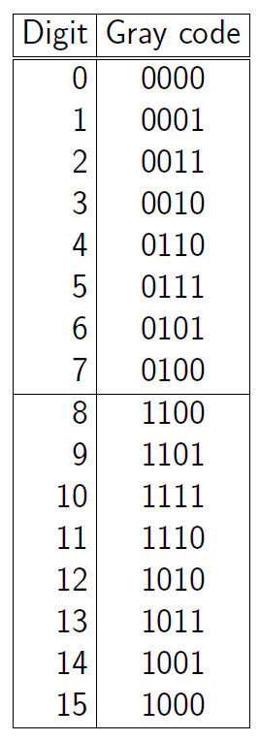
Gray code
20 in 5-bit gray code?
20 in a binary: 10100
Perform XOR with its left bit
Assume that there is a zero in the left of the MSB.
(0)10100
-> 11110 (20 in gray code)
32 (100000) in gray code -> 110000

Slide 4
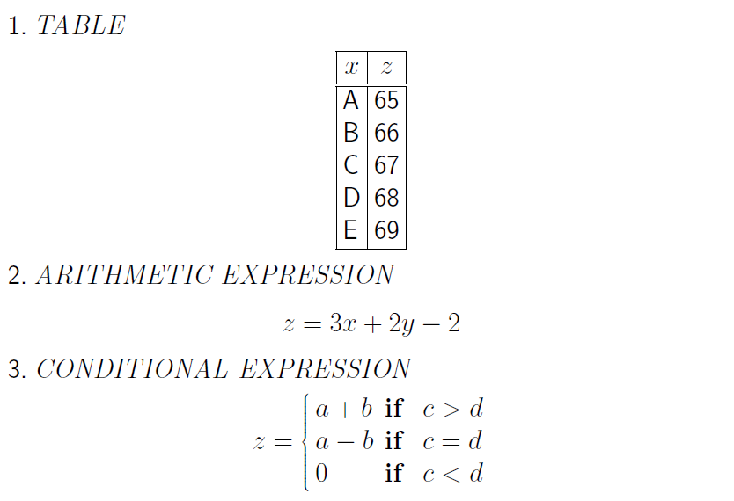
Function Expression

Slide 5
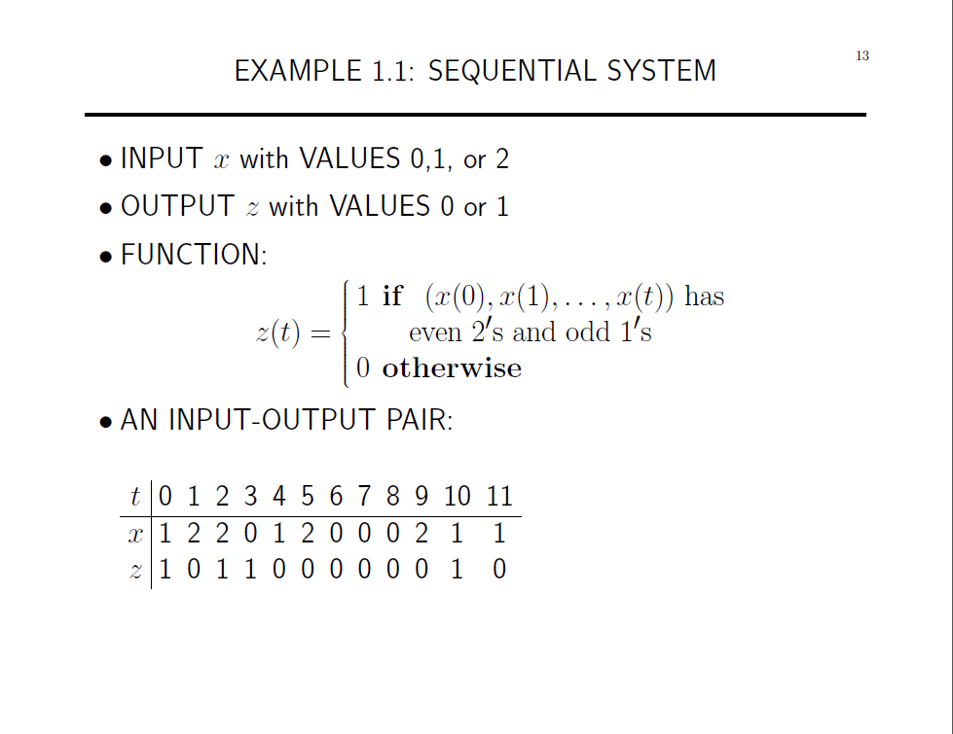

Slide 6
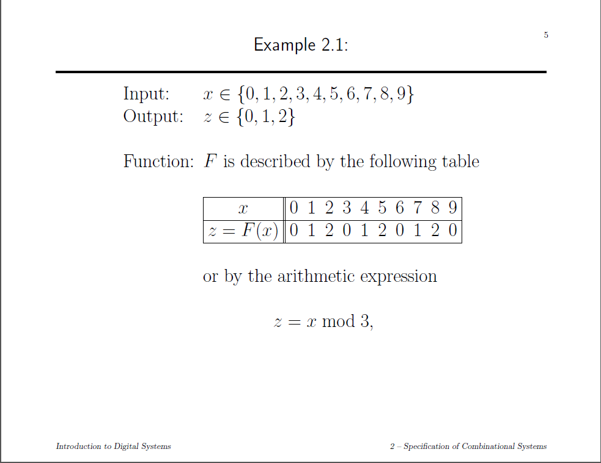

Slide 7
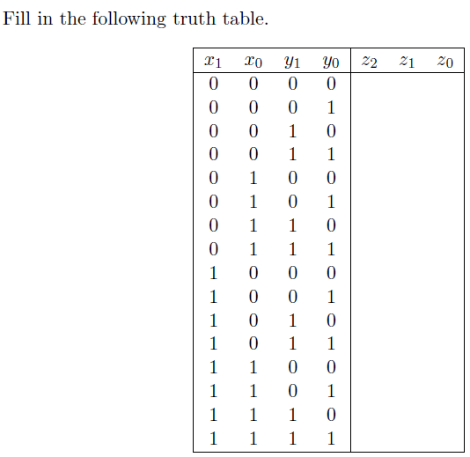
0 0 0
0 0 1
0 1 0
0 1 1
0 0 1
0 1 0
0 1 1
1 0 0
1 0 0
1 0 1
1 1 0
1 1 1
- - -
- - -
- - -
- - -

Slide 8
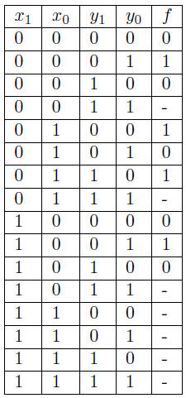

f(x, y) is a function which accepts inputs x, y ∈ {0, 1, 2}. We use the binary code to encode x and y. The following is the tabular form of the function f.
Describe the function f(x, y).
f(x, y) = (x+y) mod 2
-> The even parity of x + y

Slide 9
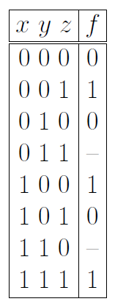
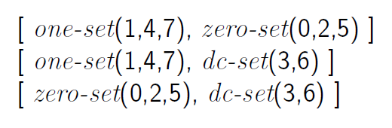
Switching Expression

Slide 10
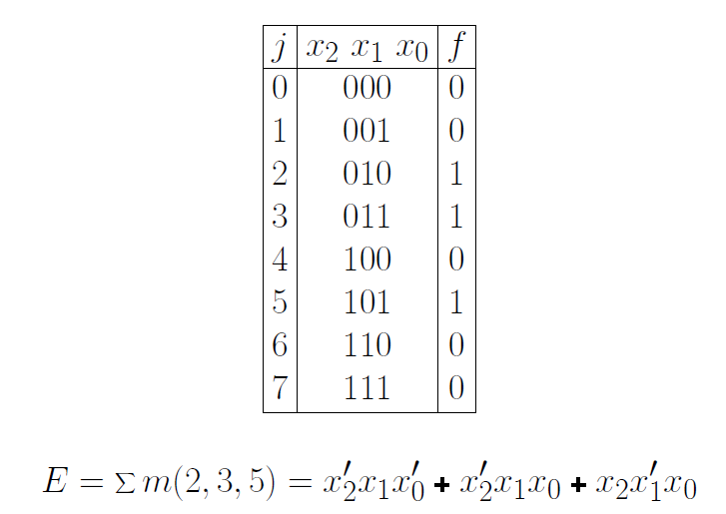
Sum of Products (minterms)

Slide 11
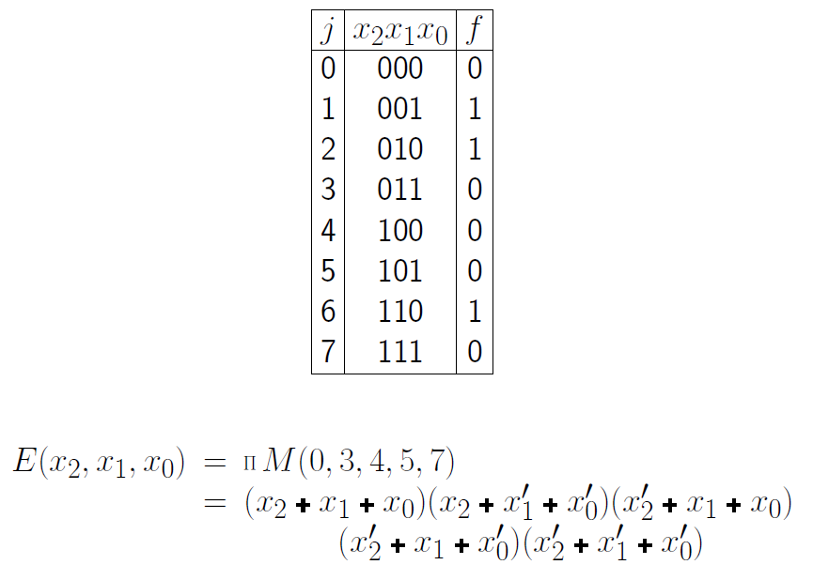
Product of Sums (Maxterms)

Slide 12
Ex2.18: A lock control
Input: CLASS ∈ {0, 1, 2, 3}
GROUP ∈ { A, B, C }
Output: LOCK ∈ { OPEN, CLOSED}
Function: LOCK
OPEN if CLASS≥2 and GROUP = A
CLOSE otherwise
->get a switching expression of Lock.

Slide 13
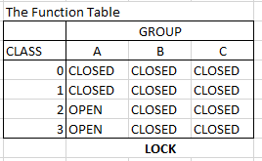
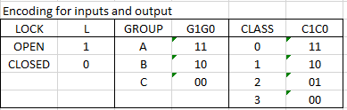

Slide 14
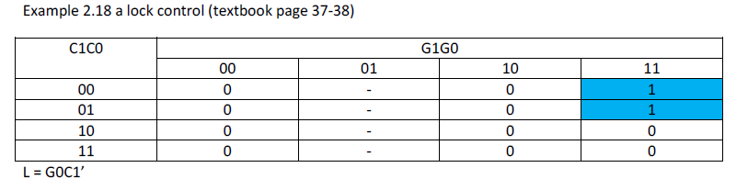
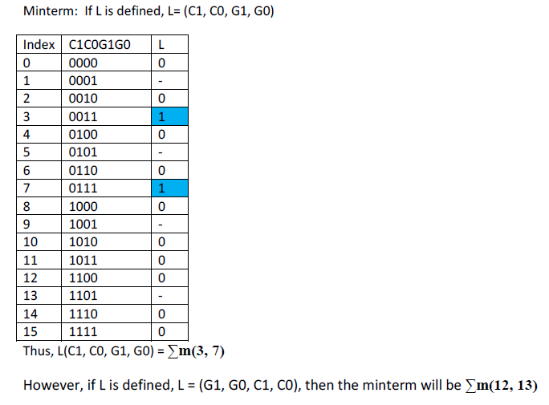
L=C1’C0’G1G0 + C1’C0G1G0
= C1’G1G0(C0’ + C0)
= C1’G1G0 -> simplified one
K-map minimizes to C1’G0 due to don’t care

Slide 15
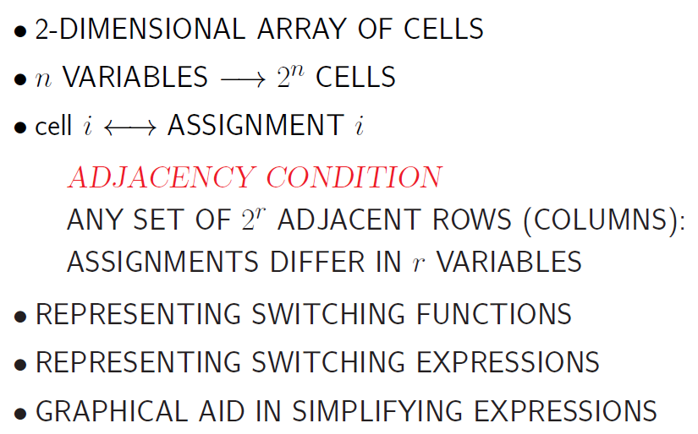
K-map

Slide 16
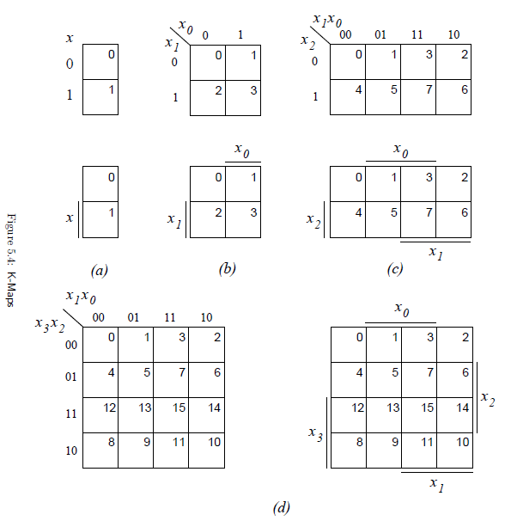

Slide 17
Minimization of SOP (POS)
Implicant <-> Implicate (POS)
Product term for which f=1
Prime Implicant
Implicant not covered by another implicant
Essential Prime Implicant
At least one “CELL” not included in other implicant

Slide 18
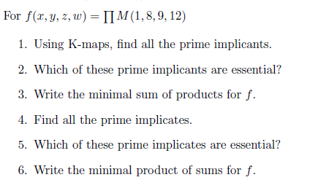

Slide 19
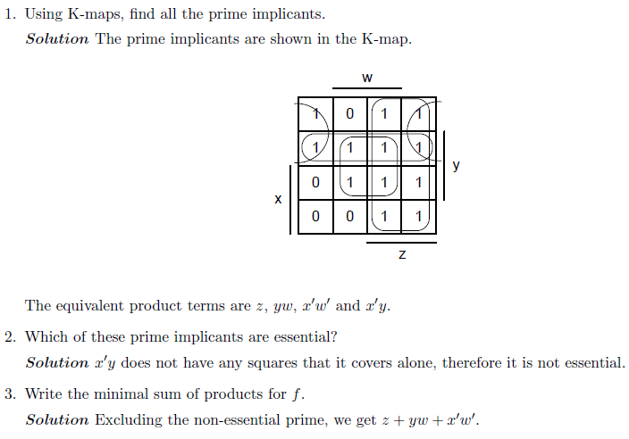
Solution 1/2

Slide 20
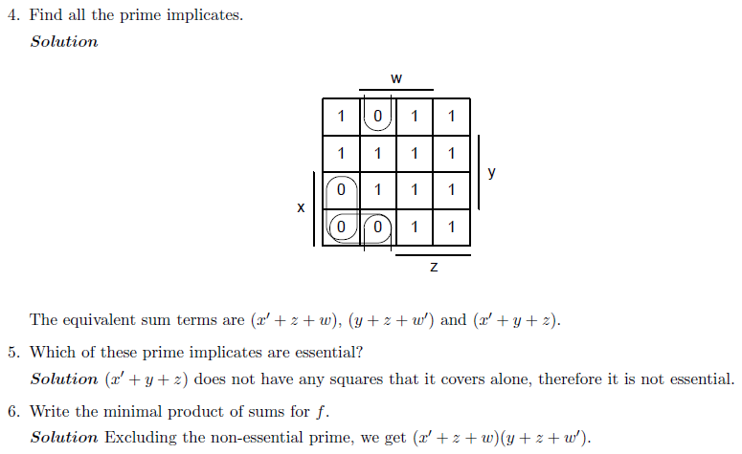
Solution 2/2

Slide 21
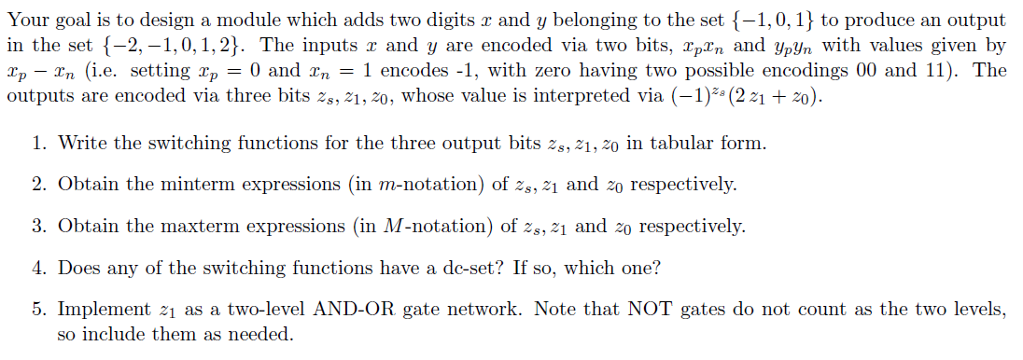

Slide 22

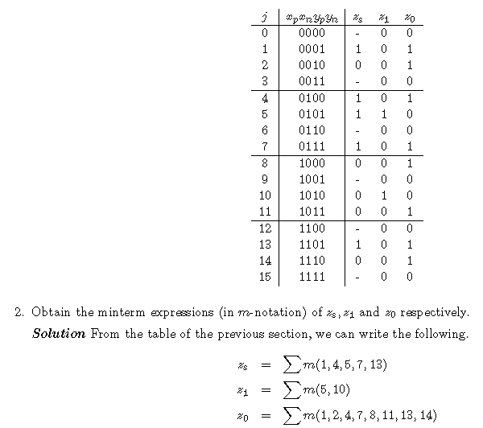

Slide 23
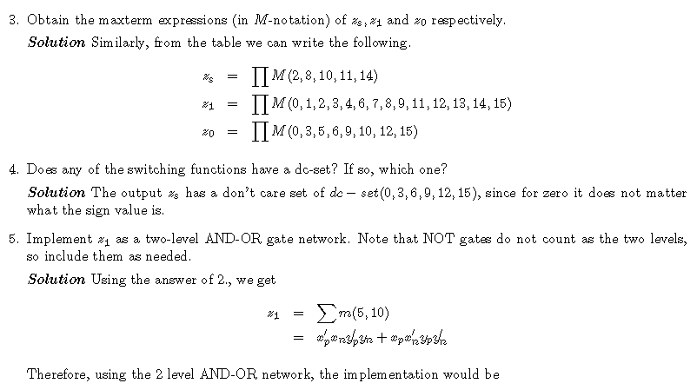
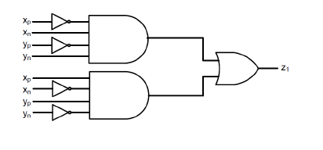

Slide 24
SOP ↔ POS
Single product term or Single sum term
SOP is same as POS vice-versa
Since there are interpreted in both ways.
Example
 | The term can be interperted either way.
 | SOP | POS
a | Single product | Single sum
ab | Single product | two sums
abc | Single product | three sums
abcd | Single product | four sums
a+b | two products | Single sum
a+b+c | three products | Single sum
b+c+d | three products | Single sum
a+b+c+d | four products | Single sum

Slide 25
SOP ↔ POS
Use distributive property more than single term
SOP -> POS
A+(BC) = (A+B)(A+C)
POS -> SOP
A(B+C) = AB + AC
Simplified SOP and its corresponding simplified POS
If don’t care exists, the conversion does not always work.
SOP | POS
ab + c | (a+c)(b+c)
ab+c+d =(a+c)(b+c)+d =(a+c+d)(b+c+d) | (a+c+d)(b+c+d)
ab+bc | (a+c)b
ab+bc+d =b(a+c)+d =(b+d)(d+(a+c)) =(b+d)(a+c+d) | (b+d)(a+c+d)

Slide 26
Universal Set
A set of gates is said to be universal if any combinational system can be implemented using gates just from that set.
Set {AND, OR, NOT}
Set {AND, NOT}
Set {OR, NOT}
Set {NAND}
Set {NOR}

Slide 27
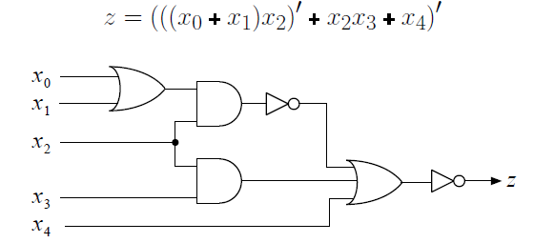
Set {AND, OR, NOT}
Any comb. system can be described by a set of switching expressions
One to One mapping
a switching expression ↔ an AND-OR-NOT network

